Slide 1
ARIMA models-2 Forecasting. Estimation. ARIMA. Model selection.
Lecture 5

Slide 2
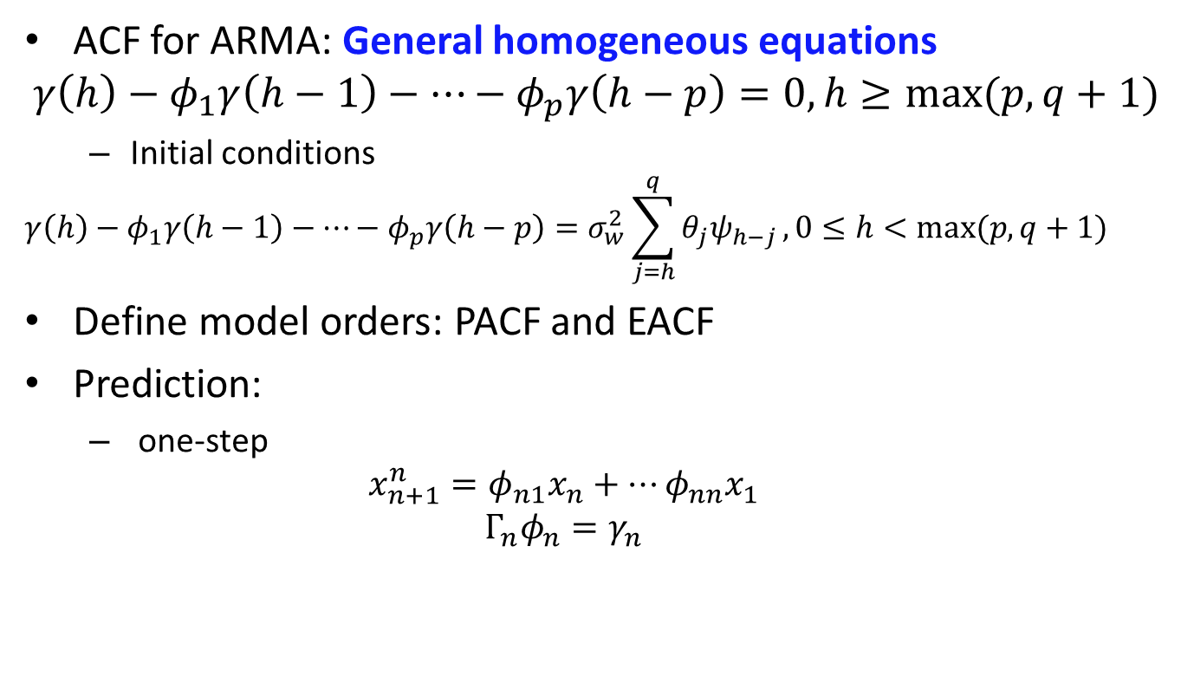
Recap
ACF for ARMA: General homogeneous equations
$$γ\left(h\right)−φ_{1}γ\left(h−1\right)−…−φ_{p}γ\left(h−p\right)=0, h≥max⁡(p,q+1)$$
Initial conditions
$$γ\left(h\right)−φ_{1}γ\left(h−1\right)−…−φ_{p}γ\left(h−p\right)=σ_{w}^{2}\sum_{j=h}^{q}{θ_{j}ψ_{h−j}}, 0≤h<max⁡(p,q+1)$$
Define model orders: PACF and EACF
Prediction:
one-step
$$x_{n+1}^{n}=φ_{n1}x_{n}+…φ_{nn}x_{1}$$
$$Γ_{n}φ_{n}=γ_{n}$$

Slide 3
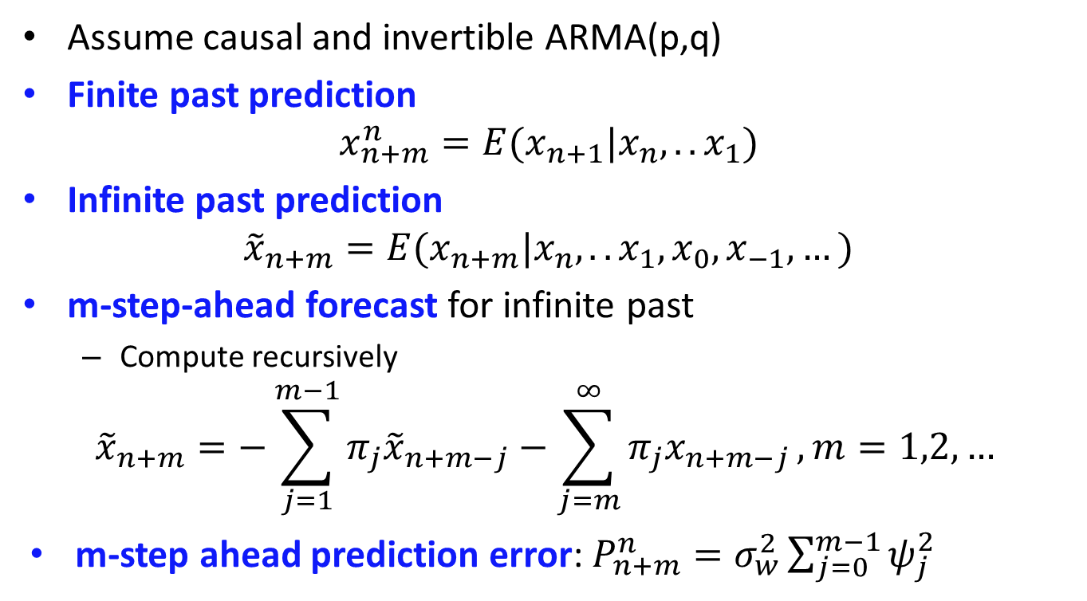
m-step-ahead for ARMA
Assume causal and invertible ARMA(p,q)
Finite past prediction
$$x_{n+m}^{n}=E(x_{n+1}|x_{n}, ..x_{1})$$
Infinite past prediction
$${\tilde{x}}_{n+m}=E(x_{n+m}|x_{n}, ..x_{1}, x_{0},x_{−1},…)$$
m-step-ahead forecast for infinite past
Compute recursively
$${\tilde{x}}_{n+m}=−\sum_{j=1}^{m−1}{π_{j}{\tilde{x}}_{n+m−j}−\sum_{j=m}^{∞}{π_{j}x_{n+m−j}}}, m=1,2,…$$
m-step ahead prediction error: $P_{n+m}^{n}=σ_{w}^{2}\sum_{j=0}^{m−1}{ψ_{j}^{2}}$

Slide 4

Long-range forecasts
What if $m→∞?$
$${\tilde{x}}_{n+m}→0 (or μ)$$
$$P_{n+m}^{n}→σ_{x}^{2}$$

Slide 5
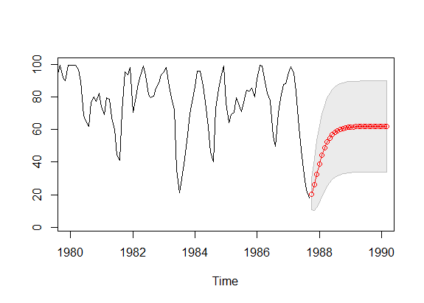

m-step-ahead
Recruitment, AR(2)
$$x_{n+m}^{n}±2\sqrt{P_{n+m}^{n}}$$

Slide 6
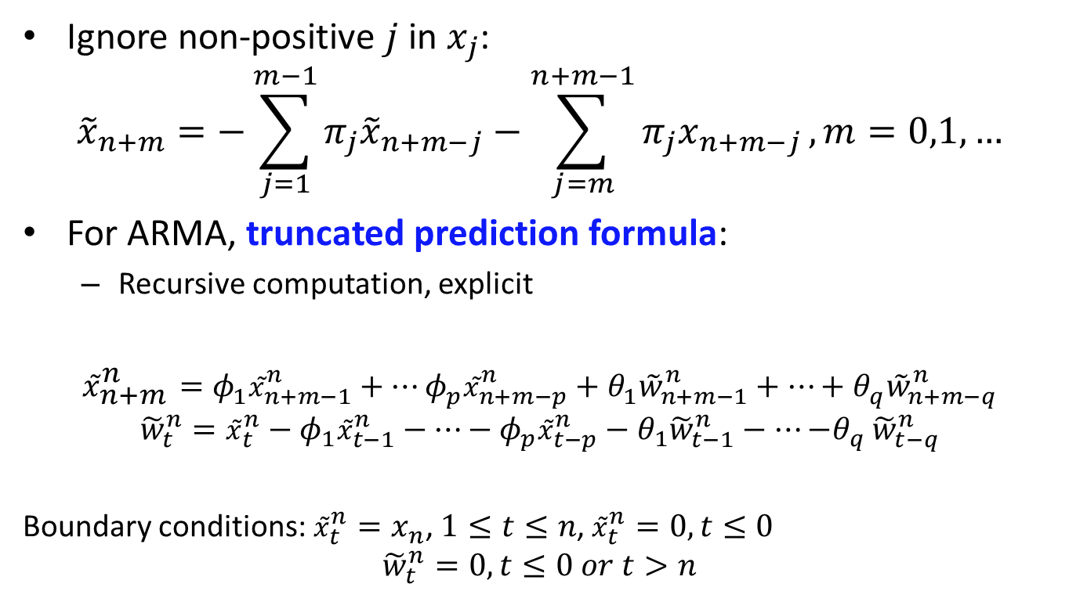
Truncated prediction
Ignore non-positive $j$ in $x_{j}$:
$${\tilde{x}}_{n+m}=−\sum_{j=1}^{m−1}{π_{j}{\tilde{x}}_{n+m−j}−\sum_{j=m}^{n+m−1}{π_{j}x_{n+m−j}}}, m=0,1,…$$
For ARMA, truncated prediction formula:
Recursive computation, explicit
$${\tilde{x}}_{n+m}^{n}=φ_{1}{\tilde{x}}_{n+m−1}^{n}+…φ_{p}{\tilde{x}}_{n+m−p}^{n}+θ_{1}{\tilde{w}}_{n+m−1}^{n}+…+θ_{q}{\tilde{w}}_{n+m−q}^{n}$$
$${\tilde{w}}_{t}^{n}={\tilde{x}}_{t}^{n}−φ_{1}{\tilde{x}}_{t−1}^{n}−…−φ_{p}{\tilde{x}}_{t−p}^{n}−θ_{1}{\tilde{w}}_{t−1}^{n}−…{−θ}_{q}{\tilde{w}}_{t−q}^{n}$$
Boundary conditions:${\tilde{x}}_{t}^{n}=x_{n}$, $1≤t≤n$, ${\tilde{x}}_{t}^{n}=0, t≤0$
$${\tilde{w}}_{t}^{n}=0, t≤0 or t>n$$

Slide 7
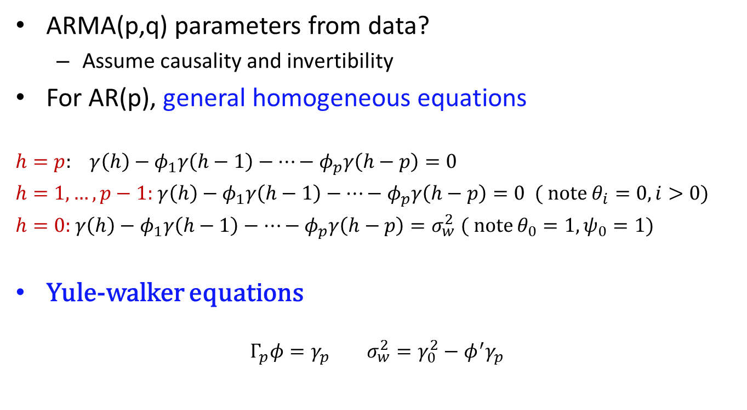
Estimation
ARMA(p,q) parameters from data?
Assume causality and invertibility
For AR(p), general homogeneous equations
$h=p:$ $γ\left(h\right)−φ_{1}γ\left(h−1\right)−…−φ_{p}γ\left(h−p\right)=0$
$h=1,…,p−1:$ $γ\left(h\right)−φ_{1}γ\left(h−1\right)−…−φ_{p}γ\left(h−p\right)=0$ ( note $θ_{i}=0, i>0)$
$h=0:$ $γ\left(h\right)−φ_{1}γ\left(h−1\right)−…−φ_{p}γ\left(h−p\right)=σ_{w}^{2}$ ( note $θ_{0}=1, ψ_{0}=1)$
Yule-walker equations
$$Γ_{p}φ=γ_{p} σ_{w}^{2}=γ_{0}^{2}−φ^{′}γ_{p}$$

Slide 8
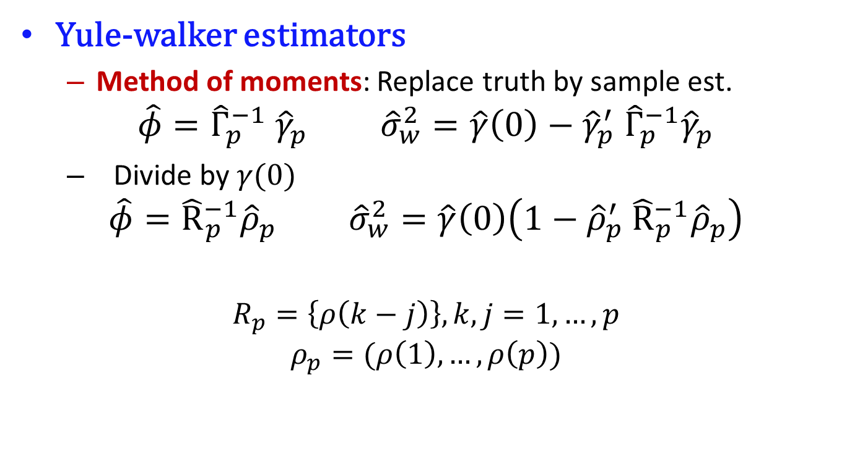
Estimation
Yule-walker estimators
Method of moments: Replace truth by sample est.
$$\hat{φ}={\hat{Γ}}_{p}^{−1} {\hat{γ}}_{p} {\hat{σ}}_{w}^{2}=\hat{γ}\left(0\right)−{\hat{γ}}_{p}^{′} {\hat{Γ}}_{p}^{−1}{\hat{γ}}_{p}$$
Divide by $γ(0)$
$$\hat{φ}={\hat{R}}_{p}^{−1}{\hat{ρ}}_{p} {\hat{σ}}_{w}^{2}=\hat{γ}\left(0\right)\left(1−{\hat{ρ}}_{p}^{′} {\hat{R}}_{p}^{−1}{\hat{ρ}}_{p}\right)$$
$$R_{p}=\left\{ρ\left(k−j\right)\right\}, k,j=1,…,p$$
$$ρ_{p}=(ρ\left(1\right),…,ρ\left(p\right))$$

Slide 9
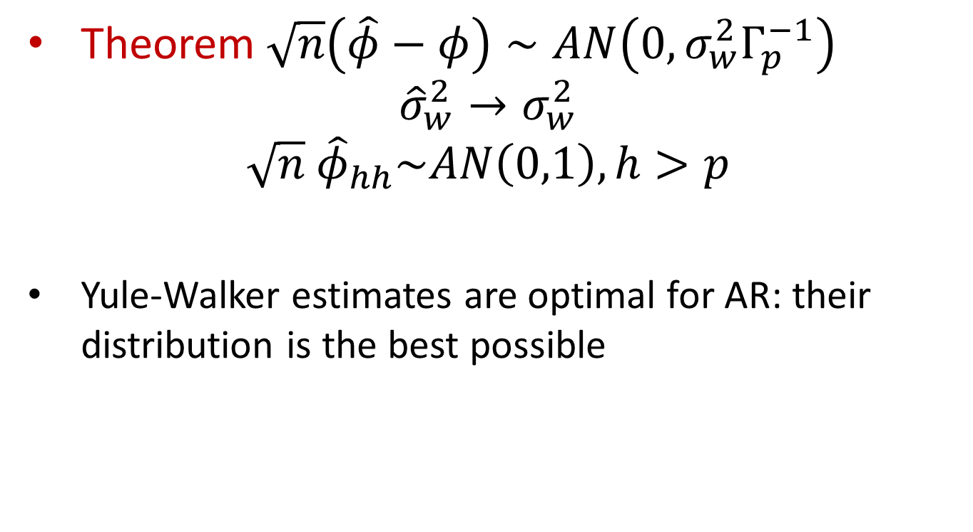
Estimation
Theorem $\sqrt{n}\left(\hat{φ}−φ\right)∼AN\left(0,σ_{w}^{2}Γ_{p}^{−1}\right)$
$${\hat{σ}}_{w}^{2}→σ_{w}^{2}$$
$$\sqrt{n} {\hat{φ}}_{hh}\sim AN\left(0,1\right), h>p$$
Yule-Walker estimates are optimal for AR: their distribution is the best possible

Slide 10
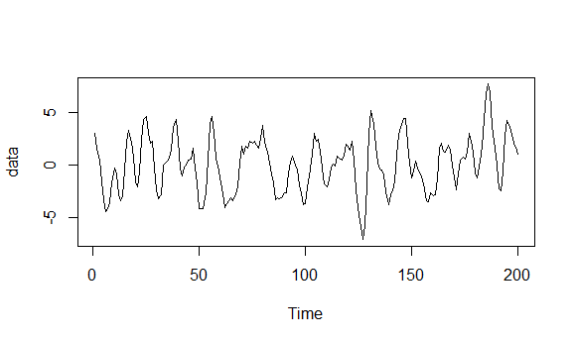

Estimation
Example
$$x_{t}=1.5x_{t−1}−0.75x_{t−2}+w_{t}$$

Slide 11
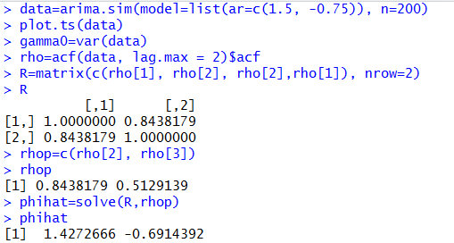
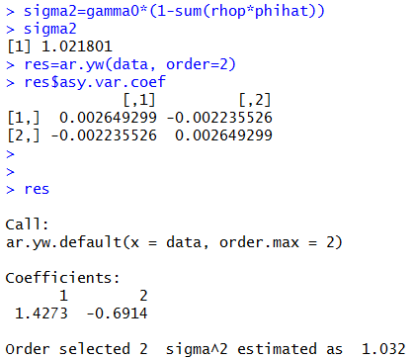
Estimation

Slide 12
Estimation
How to estimate MA(q) or ARMA(p,q)?
Estimation problems with method of moments, see MA(1)
Even if can be estimated, variance of the estimates is much greater than for other estimation methods
Other estimation methods?

Slide 13
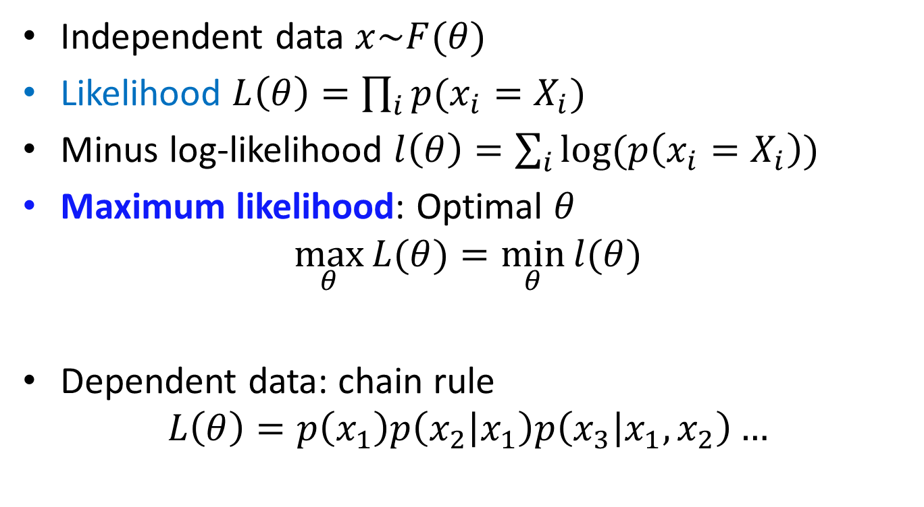
Maximum likelihood estimation: reminder
Independent data $x\sim F(θ)$
Likelihood $L\left(θ\right)=\prod_{i}{p(x_{i}=X_{i})}$
Minus log-likelihood $l\left(θ\right)=\sum_{i}{log⁡(p\left(x_{i}=X_{i}\right))}$
Maximum likelihood: Optimal $θ$
$$\max_{θ}{L(θ)}=\min_{θ}{l(θ)}$$
Dependent data: chain rule
$$L\left(θ\right)=p\left(x_{1}\right)p\left(x_{2} | x_{1}\right)p\left(x_{3} | x_{1},x_{2}\right)…$$

Slide 14
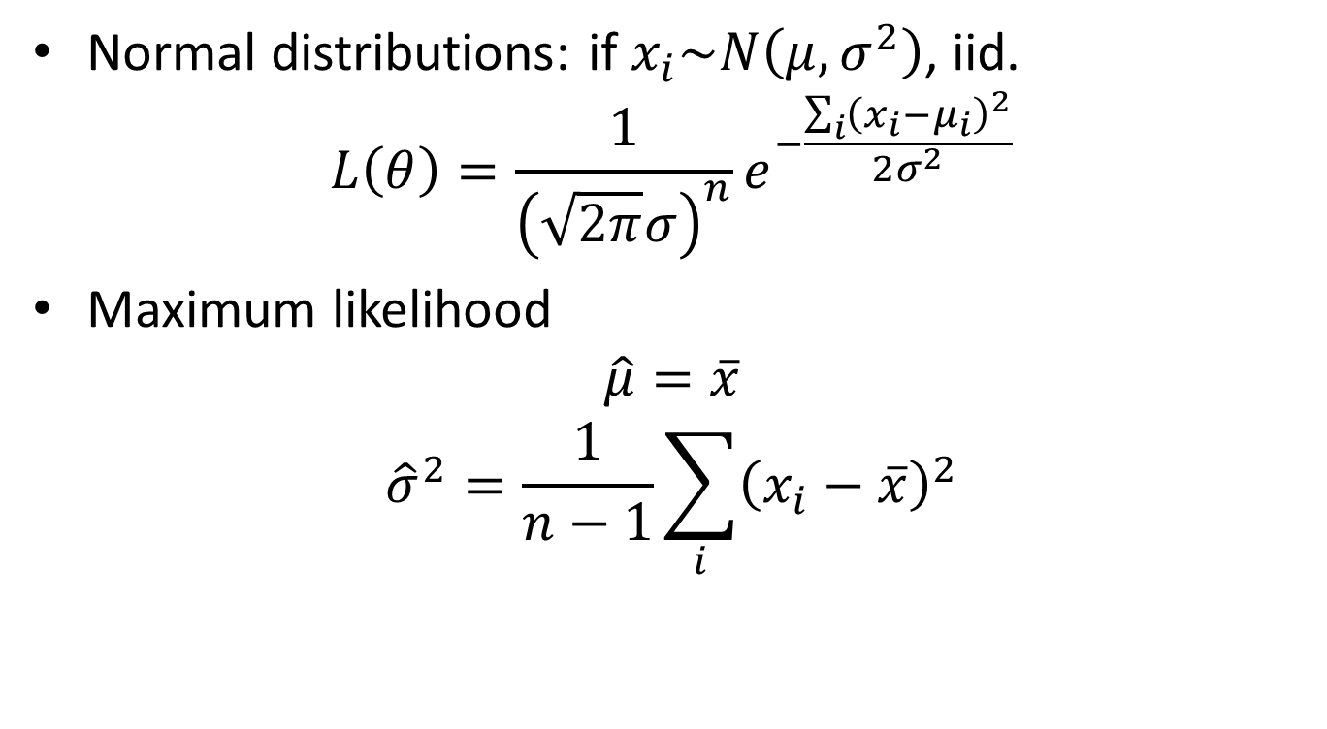
Maximum likelihood estimation: reminder
Normal distributions: if $x_{i}\sim N\left(μ,σ^{2}\right)$, iid.
$$L\left(θ\right)=\frac{1}{{\left(\sqrt{2π}σ\right)}^{n}}e^{−\frac{\sum_{i}{{\left(x_{i}−μ_{i}\right)}^{2}}}{2σ^{2}}}$$
Maximum likelihood
$$\hat{μ}=\overline{x}$$
$${\hat{σ}}^{2}=\frac{1}{n−1}\sum_{i}{{\left(x_{i}−\overline{x}\right)}^{2}}$$

Slide 15
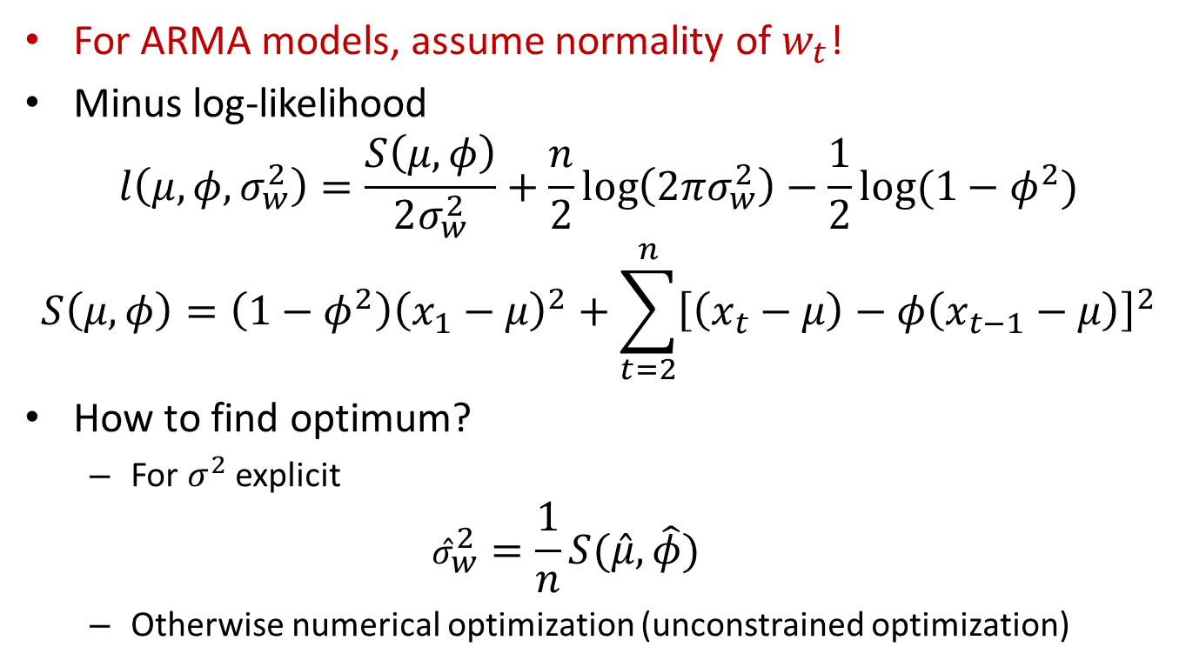
ML for AR(1)
For ARMA models, assume normality of $w_{t}$!
Minus log-likelihood
$$l\left(μ, φ, σ_{w}^{2}\right)=\frac{S\left(μ,φ\right)}{2σ_{w}^{2}}+\frac{n}{2}\log\left(2πσ_{w}^{2}\right)−\frac{1}{2}log⁡(1−φ^{2})$$
$$S\left(μ,φ\right)=\left(1−φ^{2}\right){\left(x_{1}−μ\right)}^{2}+\sum_{t=2}^{n}{{\left[\left(x_{t}−μ\right)−φ\left(x_{t−1}−μ\right)\right]}^{2}}$$
How to find optimum?
For $σ^{2}$ explicit
$${\hat{σ}}_{w}^{2}=\frac{1}{n}S(\hat{μ}, \hat{φ})$$
Otherwise numerical optimization (unconstrained optimization)

Slide 16
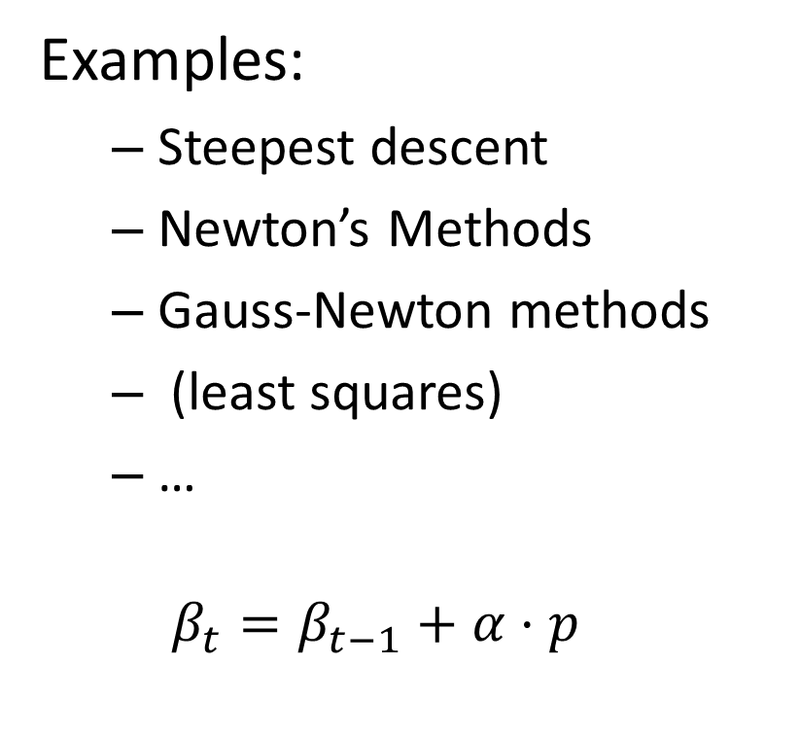
Optimization methods
Examples:
Steepest descent
Newton’s Methods
Gauss-Newton methods
(least squares)
…
$$β_{t}=β_{t−1}+α⋅p$$

Slide 17
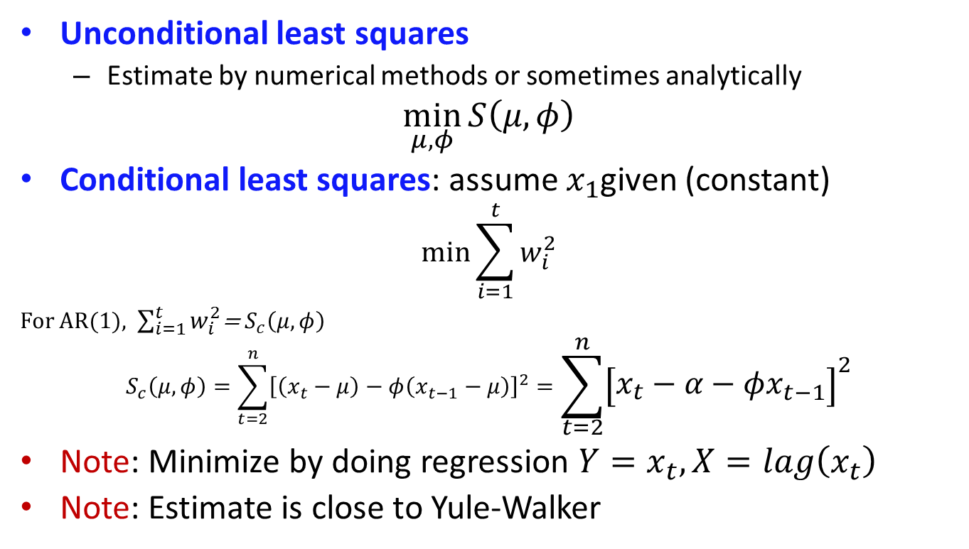
Least squares
Unconditional least squares
Estimate by numerical methods or sometimes analytically
$$\min_{μ,φ}{S\left(μ,φ\right)}$$
Conditional least squares: assume $x_{1}$given (constant)
$$\min_{}{\sum_{i=1}^{t}{w_{i}^{2}}}$$
For AR(1), $\sum_{i=1}^{t}{w_{i}^{2}}$= $S_{c}\left(μ,φ\right)$
$$S_{c}\left(μ,φ\right)=\sum_{t=2}^{n}{{\left[\left(x_{t}−μ\right)−φ\left(x_{t−1}−μ\right)\right]}^{2}}=\sum_{t=2}^{n}{{\left[x_{t}−α−φx_{t−1}\right]}^{2}}$$
Note: Minimize by doing regression $Y=x_{t}, X=lag\left(x_{t}\right)$
Note: Estimate is close to Yule-Walker

Slide 18
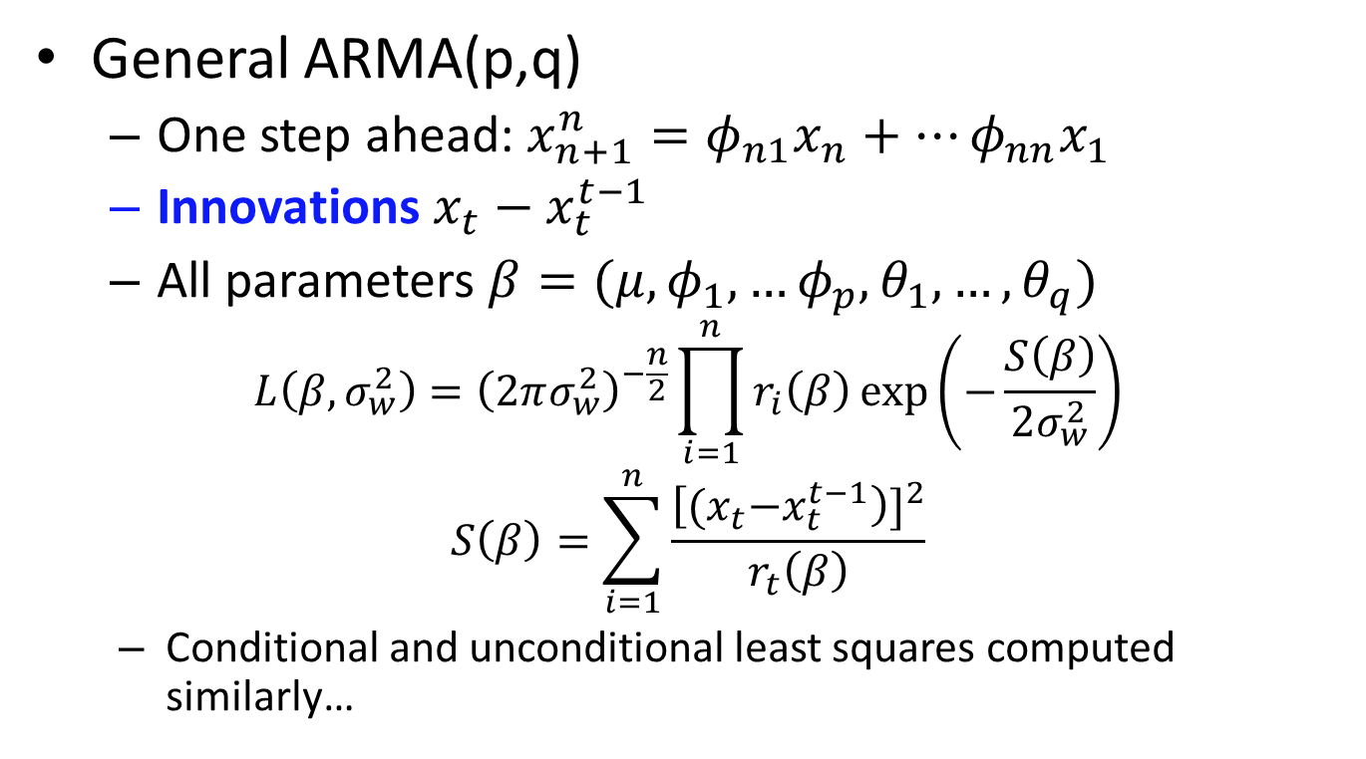
Least squares
General ARMA(p,q)
One step ahead: $x_{n+1}^{n}=φ_{n1}x_{n}+…φ_{nn}x_{1}$
Innovations $x_{t}−x_{t}^{t−1}$
All parameters $β=(μ, φ_{1},…φ_{p}, θ_{1},…,θ_{q})$
$$L\left(β, σ_{w}^{2}\right)={\left(2πσ_{w}^{2}\right)}^{−\frac{n}{2}}\prod_{i=1}^{n}{r_{i}\left(β\right)\exp\left(−\frac{S\left(β\right)}{2σ_{w}^{2}}\right)}$$
$$S\left(β\right)=\sum_{i=1}^{n}{\frac{{\left[{(x}_{t}−x_{t}^{t−1}\right)]}^{2}}{r_{t}\left(β\right)}}$$
Conditional and unconditional least squares computed similarly…

Slide 19
Estimation
Theorem. For causal and invertible ARMA(p,q) ML estimator, conditional, unconditional ML all asymptotically lead to the same (optimal) estimator.
Yule-Walker optimal for AR.

Slide 20
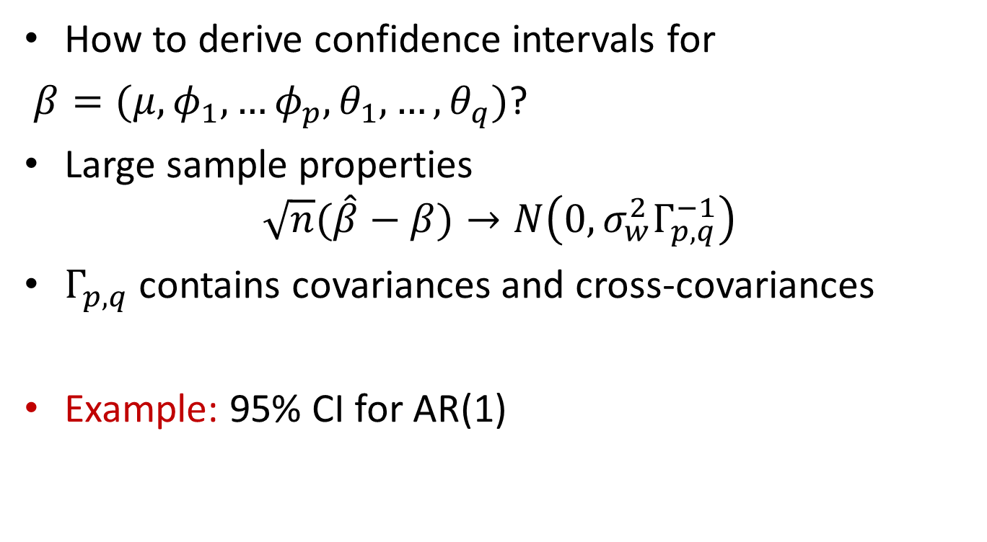
Asymptotics
How to derive confidence intervals for
$β=(μ, φ_{1},…φ_{p}, θ_{1},…,θ_{q})$?
Large sample properties
$$\sqrt{n}(\hat{β}−β)→N\left(0,σ_{w}^{2}Γ_{p,q}^{−1}\right)$$
$Γ_{p,q}$ contains covariances and cross-covariances
Example: 95% CI for AR(1)

Slide 21
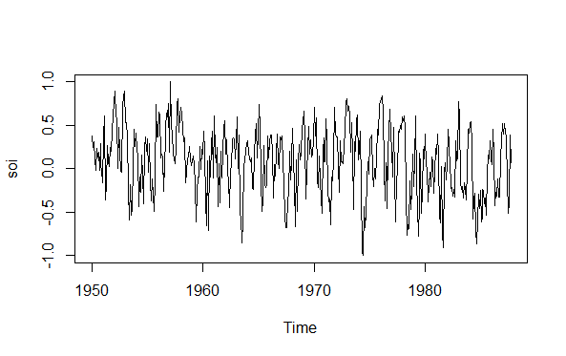
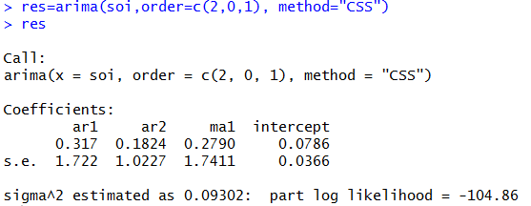
Estimation
Example: Southern Oscillation Index (SOI)
Fit ARMA(2,1)
Is this model good?

Slide 22
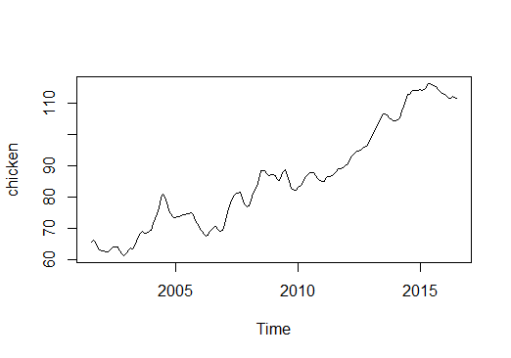
ARIMA models
ARMA for stationary models
What if not stationary?
Chicken prices

Slide 23
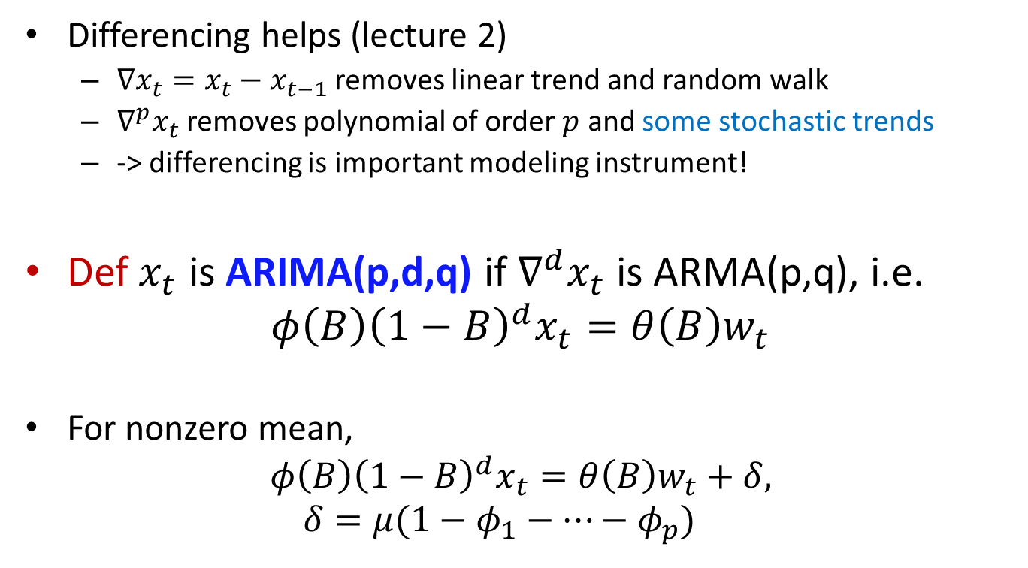
ARIMA models
Differencing helps (lecture 2)
$∇x_{t}=x_{t}−x_{t−1}$ removes linear trend and random walk
$∇^{p}x_{t}$ removes polynomial of order $p$ and some stochastic trends
-> differencing is important modeling instrument!
Def $x_{t}$ is ARIMA(p,d,q) if $∇^{d}x_{t}$ is ARMA(p,q), i.e.
$$φ\left(B\right){\left(1−B\right)}^{d}x_{t}=θ\left(B\right)w_{t}$$
For nonzero mean,
$$φ\left(B\right){\left(1−B\right)}^{d}x_{t}=θ\left(B\right)w_{t}+δ, δ=μ(1−φ_{1}−…−φ_{p})$$

Slide 24
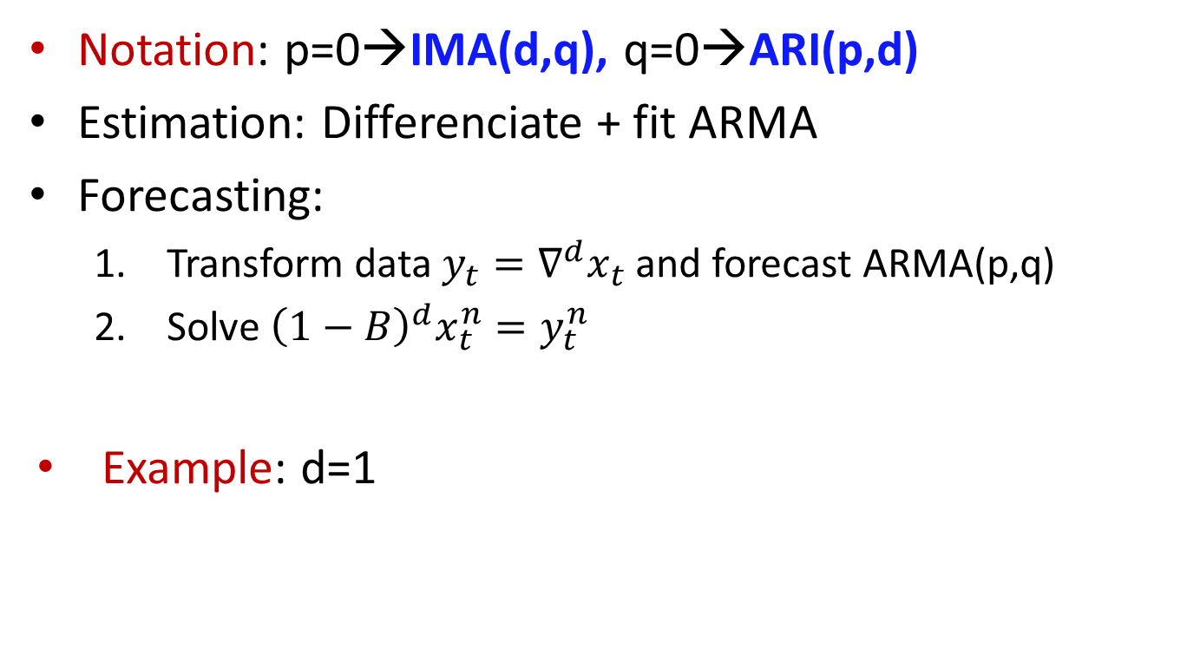
ARIMA models
Notation: p=0→IMA(d,q), q=0→ARI(p,d)
Estimation: Differenciate + fit ARMA
Forecasting:
Transform data $y_{t}=∇^{d}x_{t}$ and forecast ARMA(p,q)
Solve ${\left(1−B\right)}^{d}x_{t}^{n}=y_{t}^{n}$
Example: d=1

Slide 25

ARIMA models
Forecast: prediction errors
$$P_{n+m}^{n}≈σ_{w}^{2}\sum_{j=0}^{m−1}{ψ_{j}^{∗2}}$$
$$ψ^{∗}\left(z\right)=\frac{θ\left(z\right)}{φ\left(z\right){\left(1−z\right)}^{d}}$$
Example: IMA(1,1)

Slide 26
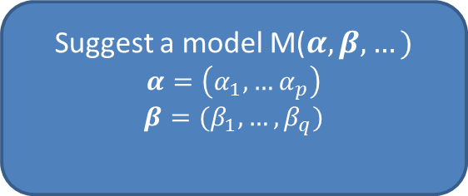
Reminder: The Big Picture
Time Series data
To achieve stationarity:
Differencing (not too much→ overfitting) → define d in ARIMA(p,d,q)
Tranfomations
Detrending
Exploratory data analysis
Make data stationary
Suggest a model M($α, β,…)$
$$α=\left(α_{1},…α_{p}\right)$$
$$β=(β_{1},…, β_{q})$$

Slide 27
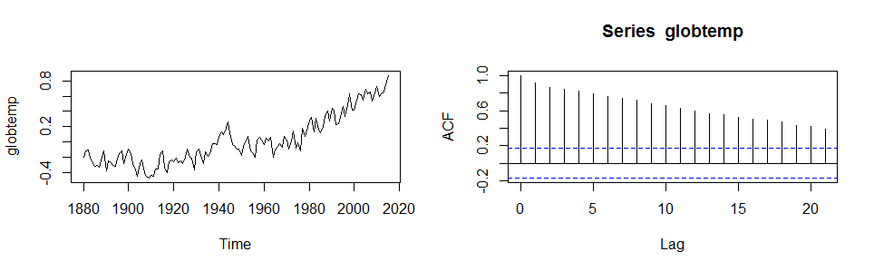

Differencing
Too much or not too much?
Example: Overdifferencing leads to more complex models, try with $x_{t}=w_{t}$
Example: Underdifferenced model? Check ACF! It will decay slowly

Slide 28
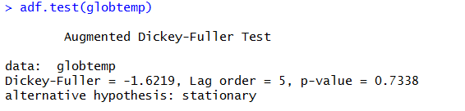

Differencing
Try unit root test:
Idea: $φ\left(B\right){\left(1−B\right)}^{d}x_{t}=φ^{′}\left(B\right)x_{t}=θ\left(B\right)w_{t}$
$$H_{0}:φ^{′}\left(B\right)has unit root$$
$$H_{a}:φ^{′}\left(B\right) does not have unit roots$$
Conclusion?

Slide 29


Reminder: The Big Picture
Suggest a model M($α, β,…)$
$$α=\left(α_{1},…α_{p}\right)$$
$$β=(β_{1},…, β_{q})$$
Model Estimation
- Estimate $α^{′}s$, $β^{′}s,…$
Revise the model
Yes
Model diagnostics or Model selection
Are p,q,… chosen inappropriately?
Are there better models with other p,q,…
Are there better models of other kind?

Slide 30
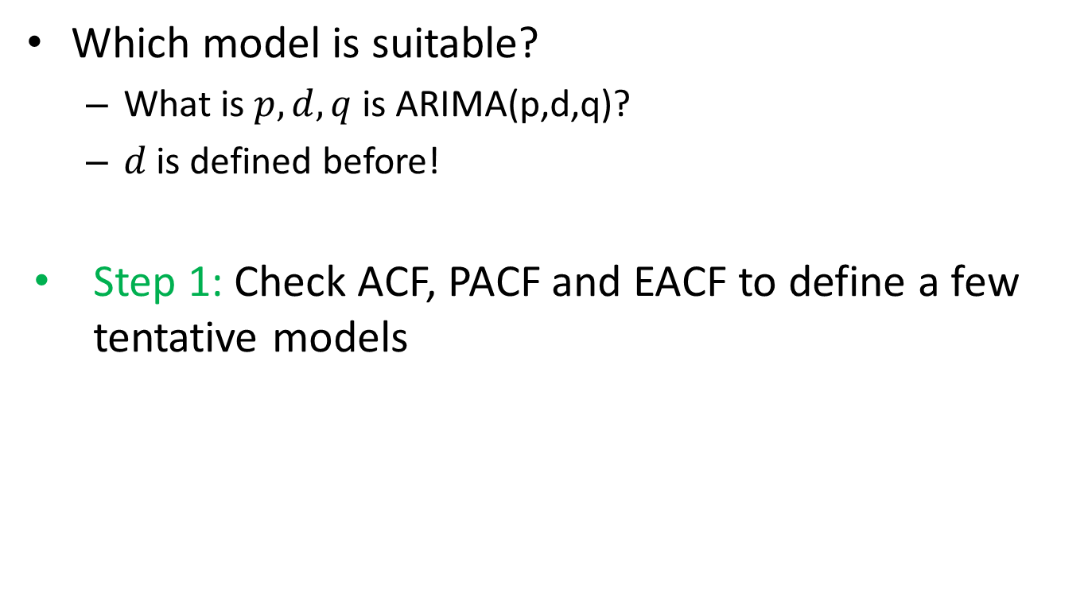
Model selection
Which model is suitable?
What is $p,d,q$ is ARIMA(p,d,q)?
$d$ is defined before!
Step 1: Check ACF, PACF and EACF to define a few tentative models

Slide 31
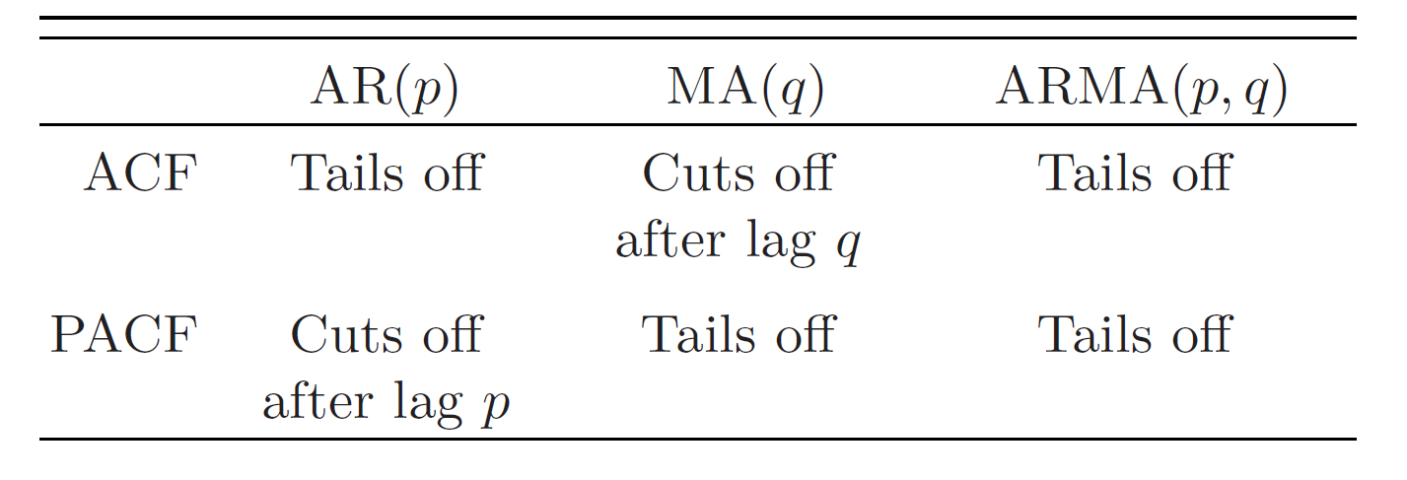
Model selection

Slide 32
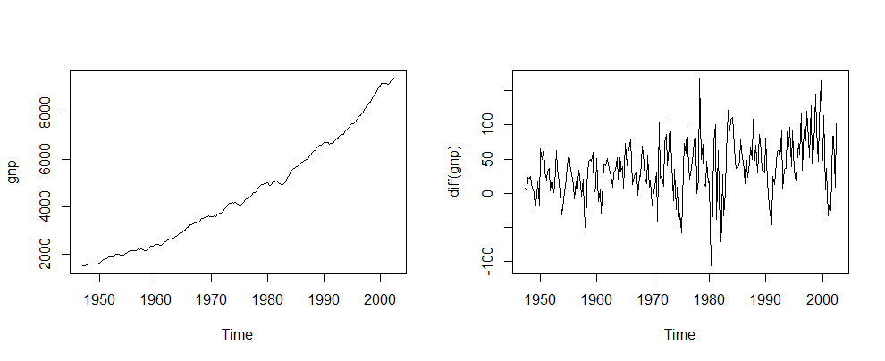
Model selection
Example: GNP data
Trying differencing→non-constant variance and maybe trend?→transformation

Slide 33
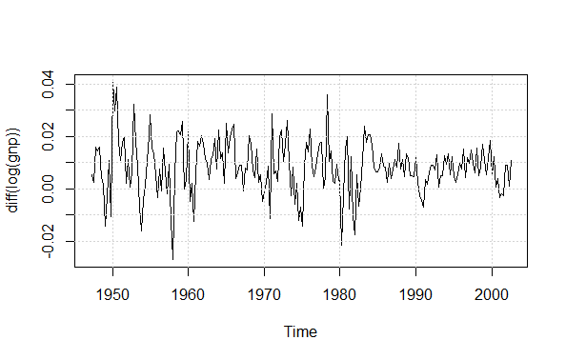
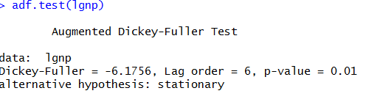
Model selection
Example: GNP data
Taking log and then differncing→still not perfect, but… keep it as is.

Slide 34
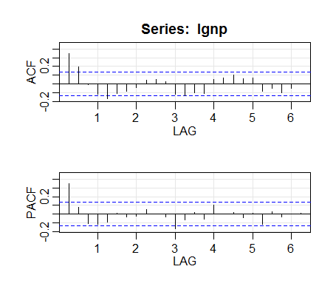
Model selection
Example: GNP data
Testing ACF and PACF
Conclusion?

Slide 35
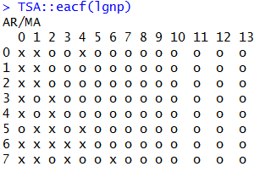
Model selection
Example: GMP data
Checking EACF
Conclusion?

Slide 36
Read home
Ch 3.5-3.7
R code: predict.Arima, ar, ar.yw, adf.test, acf2

